Slide 1

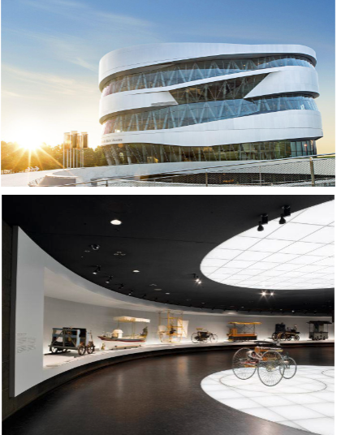
Iot project: self-driving car
Vincent leys

Slide 2
description
Mercedes benz wants to automate its museum in Stuttgart. For this they want a system that ensures that a visitor can take a seat in a self-driving car. The visitor can sit in one of these carts at the beginning of the tour and will do the entire tour of the museum. At the end of the tour, the visitor disembarks. Afterwards, the car continues to the start of the tour so that a new visitor can board. The route that the cars must follow is recorded with a white tape on the floor, this makes it possible to adjust the tour as new pieces are added. added. A white cross line will be placed on the route with each piece, so the cart knows that a museum piece is on display there and that it has to stop for a while. If the driver wants to continue, he will be able to press a push button in the cart after which the cart will continue to the next item. To avoid congestion, the cart will automatically continue driving after 5 minutes.

Slide 3
description
Optionally, they also want to control the carts remotely, for this they could take over the function of the push button with an app. It is of course also important that the carts do not collide, for this there will always be a minimum distance of 1.5m between the carts. If a cart notices that it is getting too close to the previous cart, stop it and only continue driving if the previous cart continues to drive. The carts are also equipped with LED signaling. With this signage, the personnel in the control room can see on cameras if a problem occurs. A green LED will illuminate if there are no problems, a red LED will illuminate if the cart has lost its line.

Slide 4
requirements
-The robot can autonomously follow a track indicated by a white line.
-The robot must stop at a white cross line and can continue driving if:
The driver pushes the drive-through button
The carriage is stationary for 5 minutes.
Optional: if the control center activates the cart with the app

Slide 5
requirements
The cars must not collide
if a cart is stationary, the carts behind will keep their distance and only continue when the cart passes in front of them.
If problems occur with a cart, it will be forced to stop and report this to the control center by means of LED signaling on the cart.

Slide 6

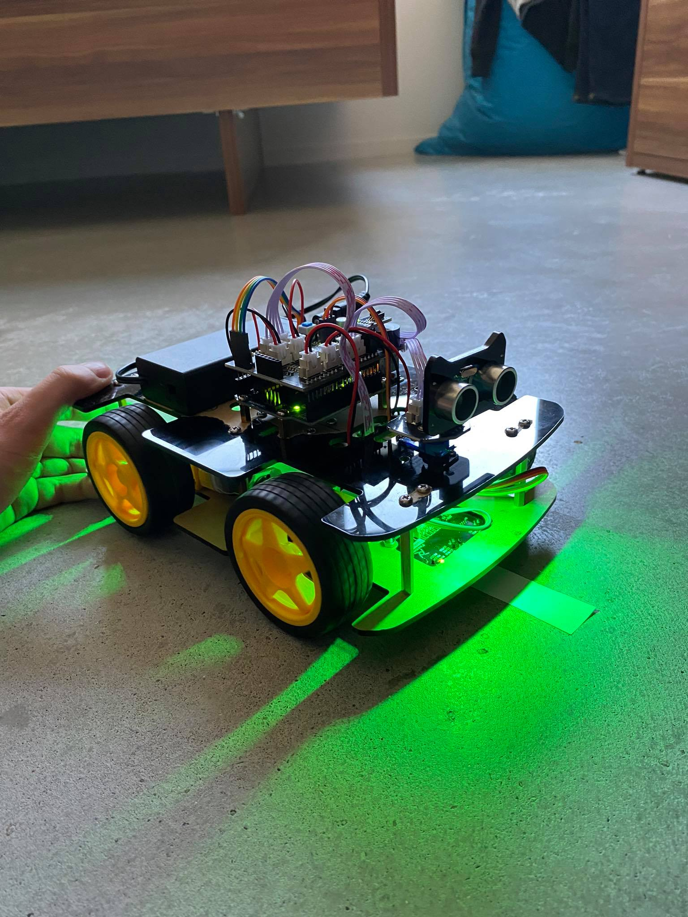
Signaling in case of problems
Green LED: No problems

Slide 7
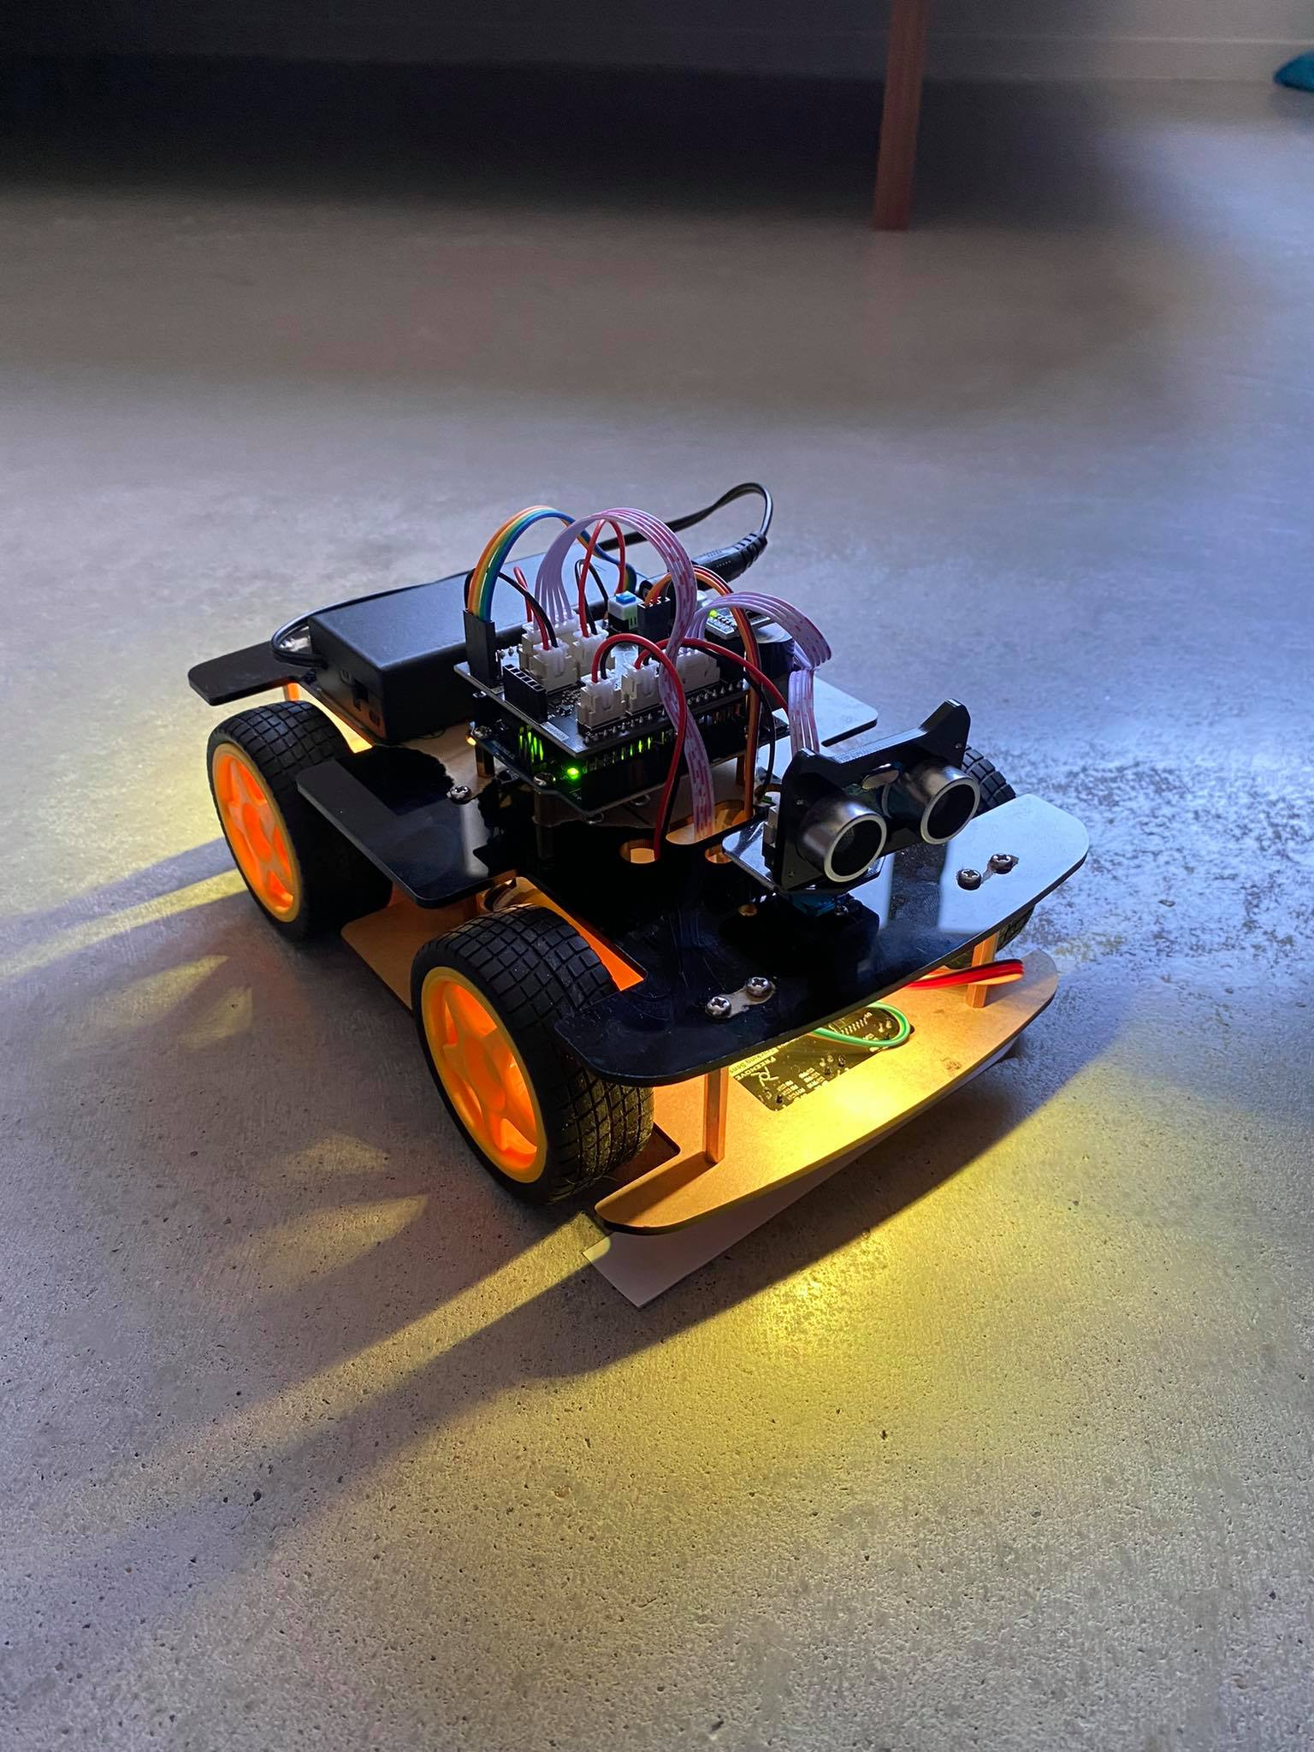
Signaling in case of problems
Orange LED: obstacle (cart or other)

Slide 8
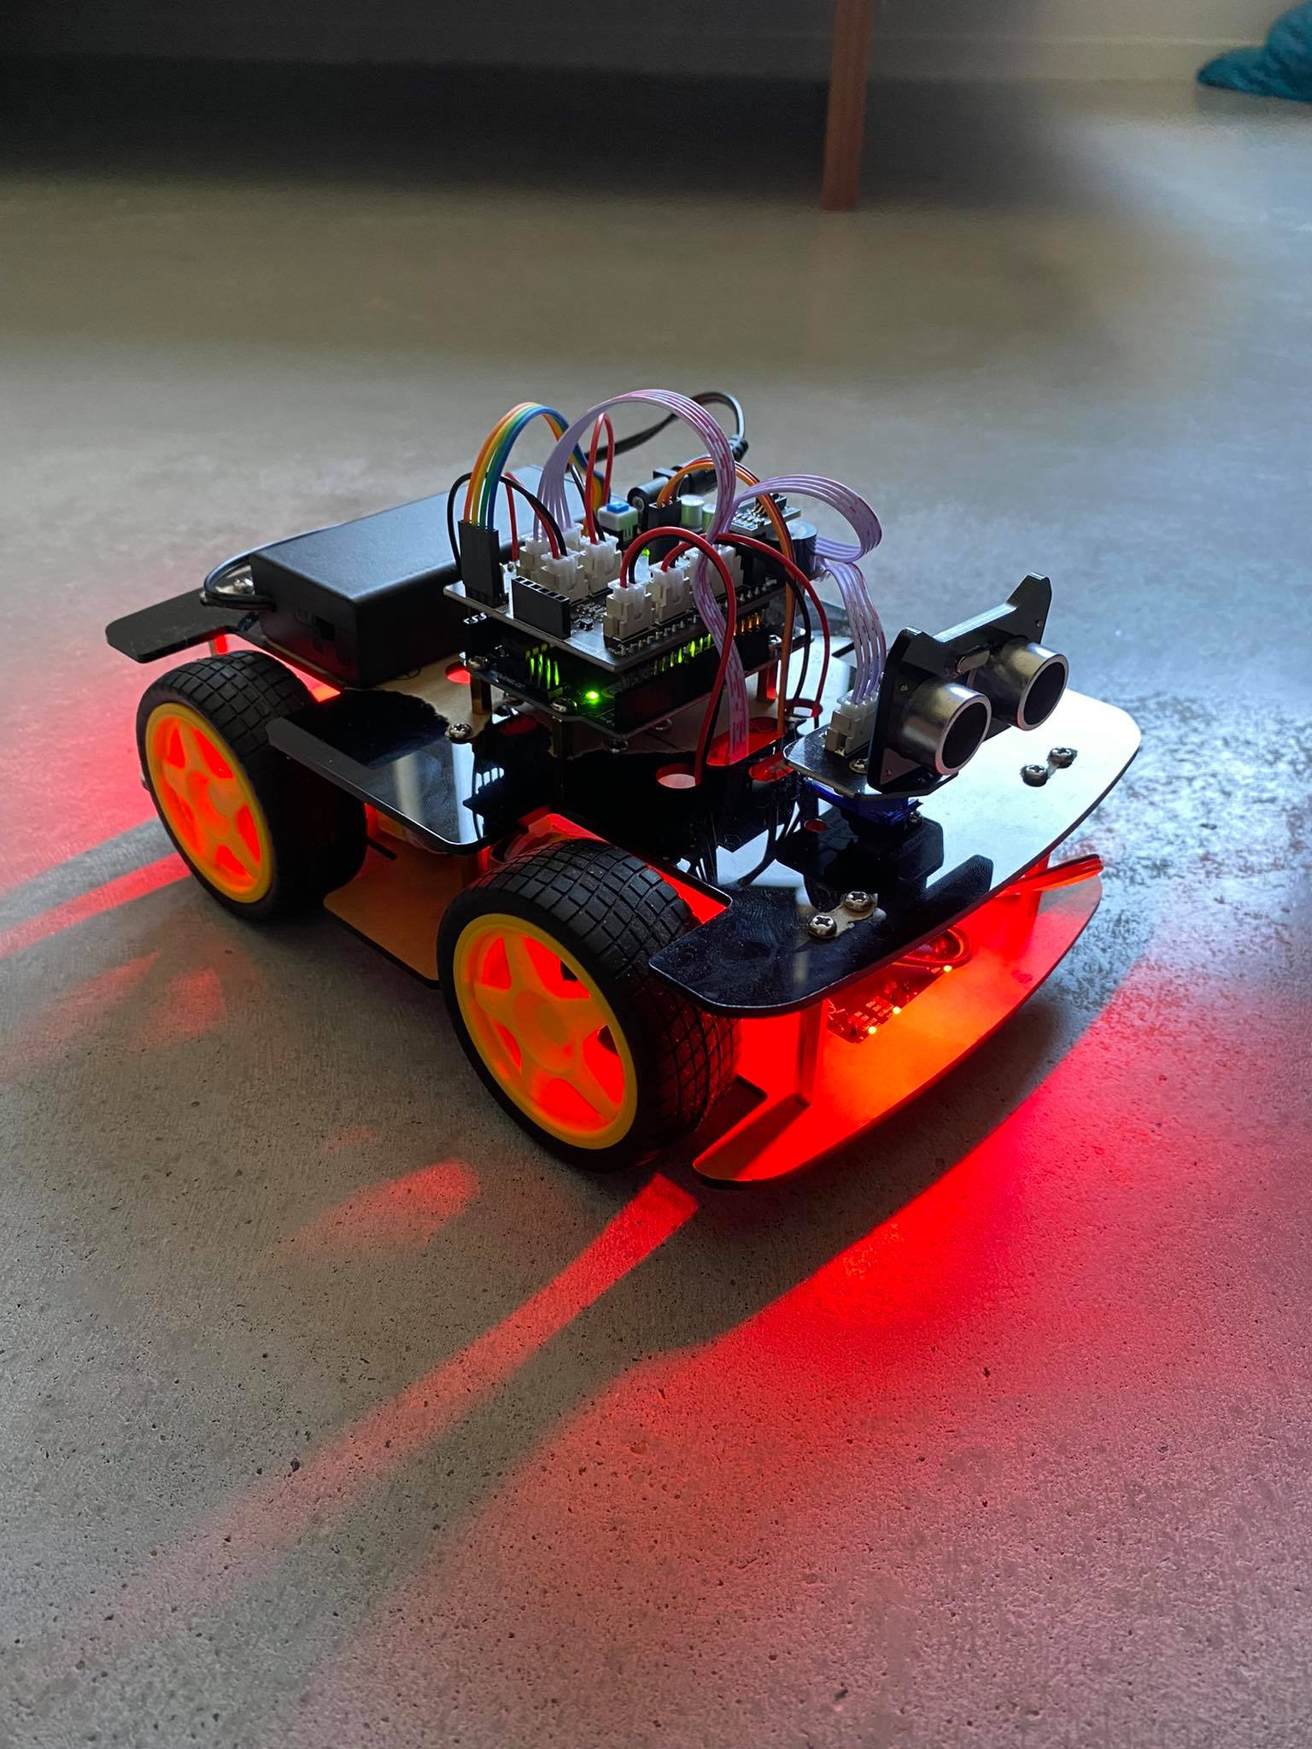
Signaling in case of problems
Red LED: Lost line

Slide 9
What to expect Mercedes-Benz
A brief description of the hardware used
Files to produce the housing
Electronics components
Schematics and PCB
Gedocumenteerde code
Brief description of how they can produce these carts themselves

Slide 10
Succession
Mercedes-Benz wants to put the cars into production after 7 weeks, for this there will be 3 assessments.
The car must be in motion within 3 weeks and have basic functionality (follow line).
After 5 weeks they want to be sure that the cars has the correct functions
Follow line, Stop and continue at cross line, Signaling

Slide 11
Succession
After 7 weeks a working prototype will be shown. This prototype will be tested for functionality and speed. The prototype may not contain any separate components, so the use of a breadboard is not allowed. At this point, all documentation must also be provided.

Slide 12
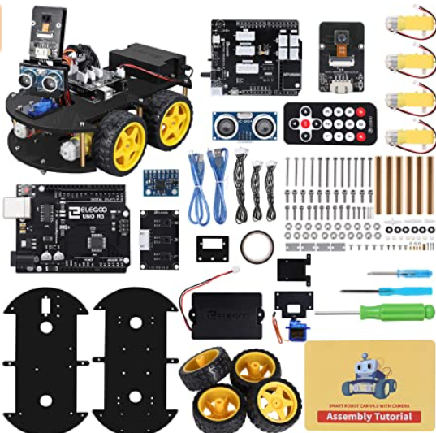
Ik heb een kit gekocht ter waarde van 39,99 euro waar ik mijn arduino uno op kan aansluiten.

Slide 13
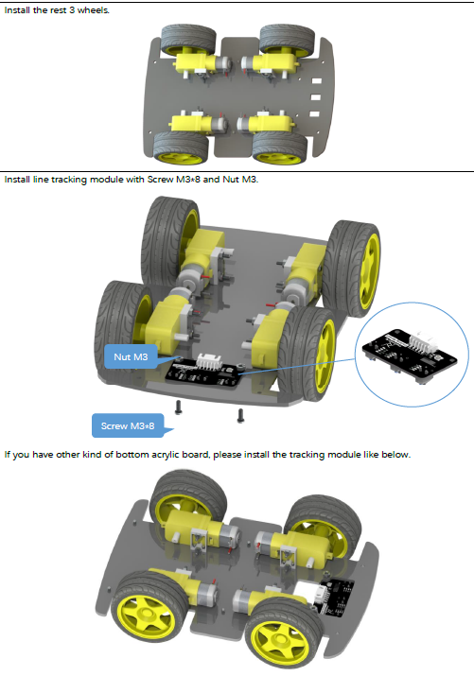
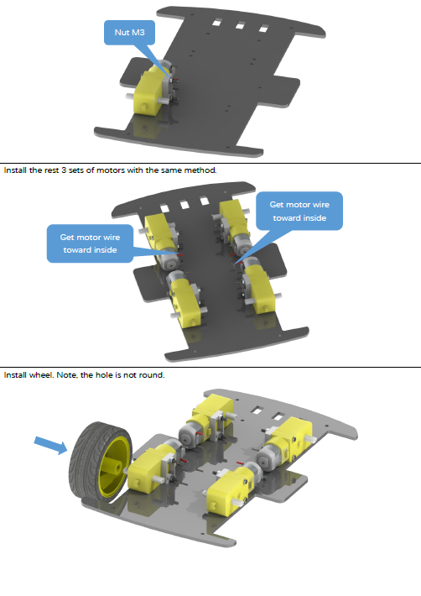
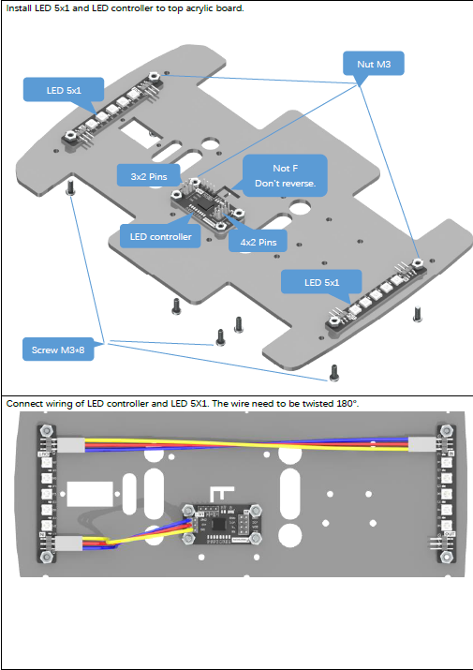
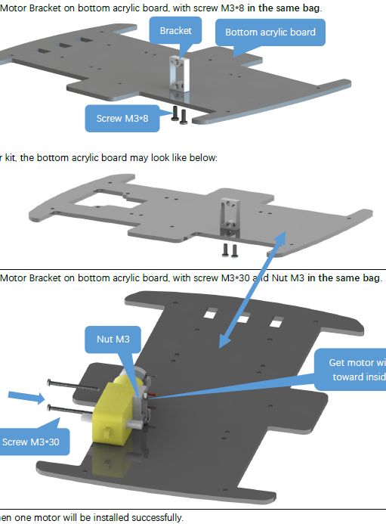
Bij de kit is er een tutorial bij om het voertuig te monteren.
https://github.com/Freenove/Freenove_4WD_Car_Kit

Slide 14
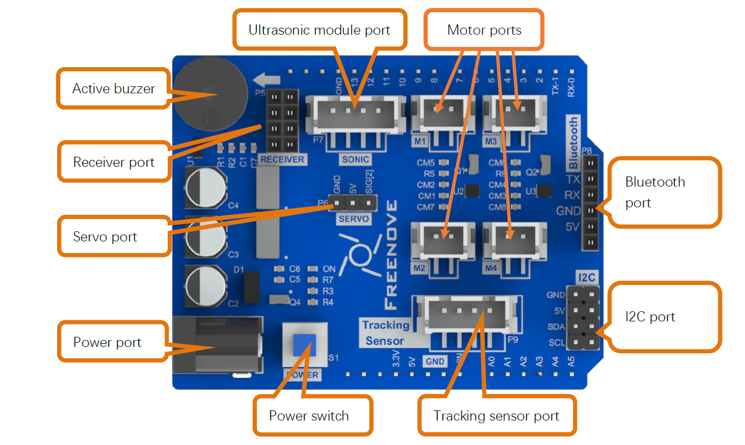
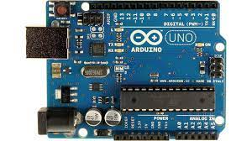
aansturing
De auto word bestuurd doormiddel van mijn Arduino uno en een control bord van freenove die de motors, led strip,… aanstuurd.

Slide 15
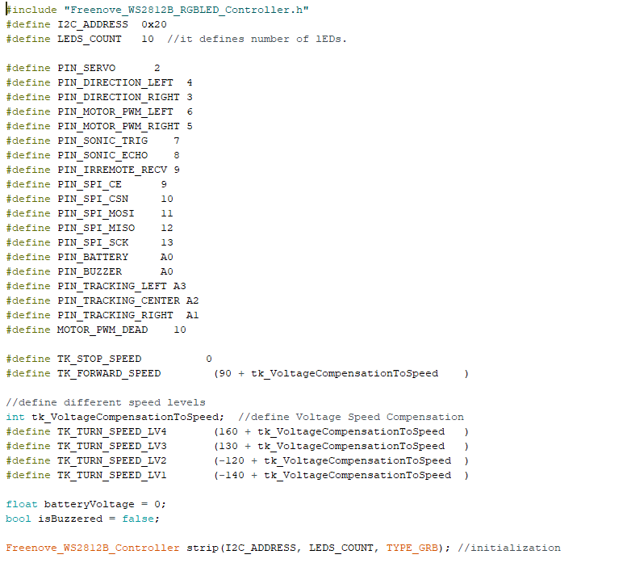
Code
Define eerst alle componenten + speed van de motors.

Slide 16
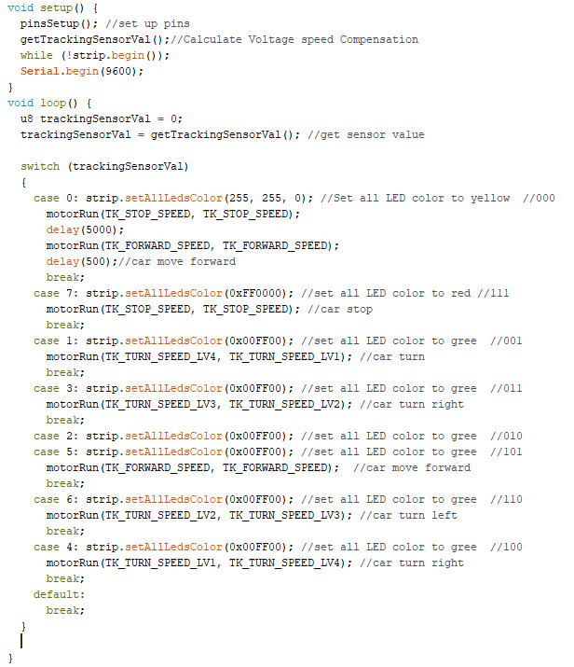
Code
Void setup + void loop
Ik maak gebruik van switch case in mijn void loop

Slide 17
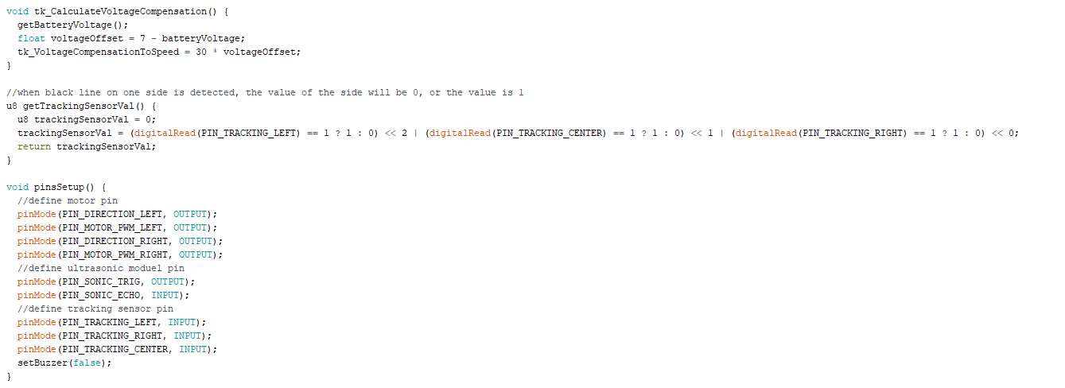
code
Battery voltage check
Tracking sensor
Defining motor pins

Slide 18
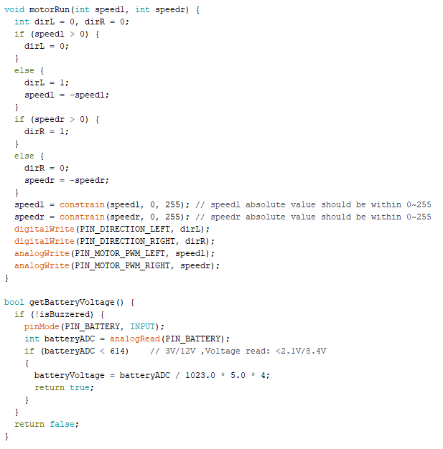
code
Motor speed en directions aanwijzen
Battery check

Slide 19
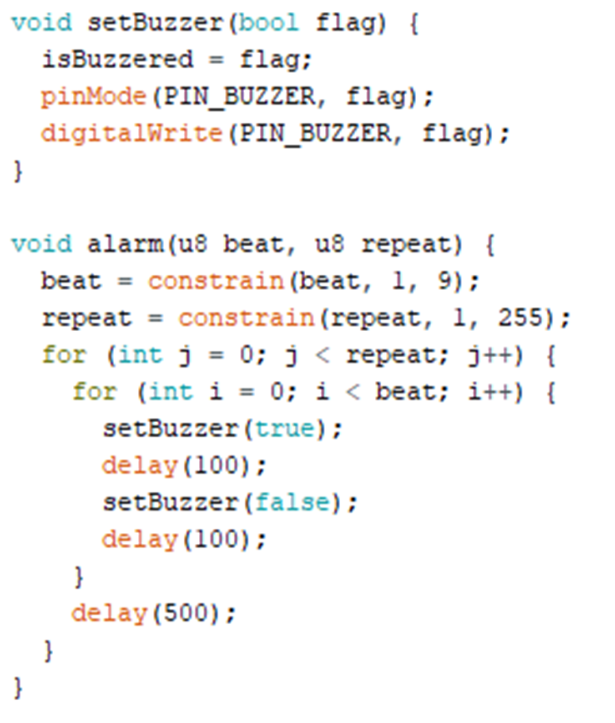
code
Laat een buzzer afgaan als de battery een te lage waarde heeft

Slide 20
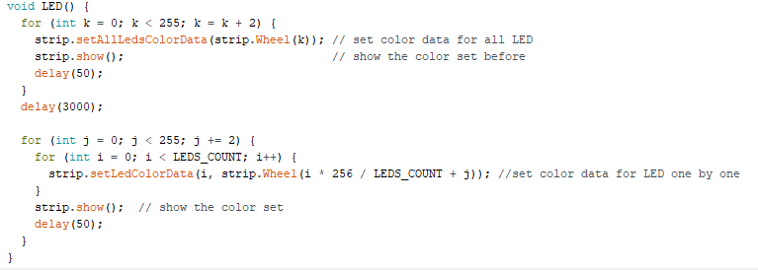
code
Toewijzing van de leds
Groen led als de auto rijd en geen problemen toont
Oranje led bij een opstakel / stop lijn
Rode led als het auto’tje de lijn kwijt is

Slide 21
Video
https://youtu.be/Oq5SqPpeIso

Slide 22
github
https://github.com/VincentLeYs/IOT-project

